Slide 1
Sitting Duck
Cellular Phone Detection for Information Sensitive Settings
March 9th, 2017
Cumulative Design Review

Slide 2
The Team
Sean Turner
EE
Michael Sheehan
EE
Jonathan Jamroga
CSE
Jonathan Yam
CSE

Slide 3
The Advisor
Notes:
Northern Harrier

Slide 4
Mission Objective
Develop a single-room detection system that identifies where and when cell phone use occurs and allow the user to easily visualize and review detection events.
- Physically Non-invasive
- Eliminate manpower and human error
- Selective video evidence
- Ease of use

Slide 5
System Requirements
Accurate
- Localize detection at 40’ range to within ±5°
- <30 second sensor to GUI presentation latency
Easy to Use Presentation
- Real video feed with 2D heat map overlay
- User can playback stored events from times of detections
Operates on commercial cellular phone frequencies
- 850MHz for proof concept
- RF BPF on PCB to filter out undesired frequency bands

Slide 6
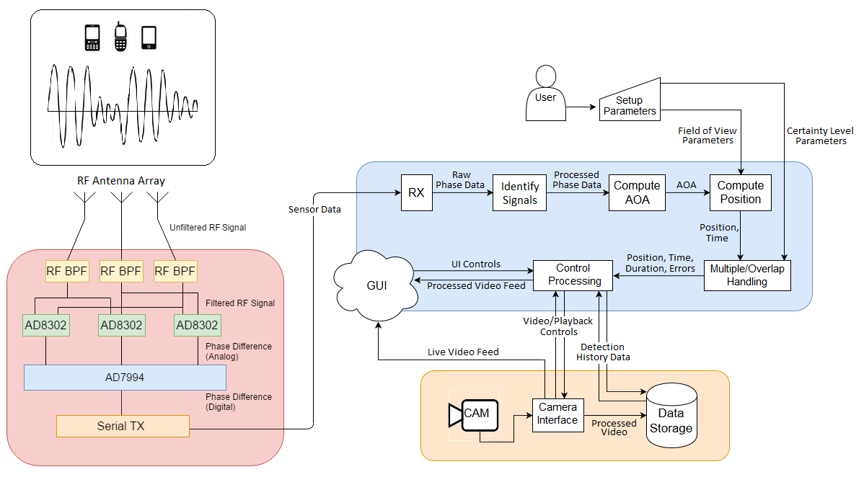
System Block Diagram

Slide 7
Chosen Components
RF Phase Detector
AD8302ARU RF IC (3x)
RF Antenna
RDA698/2700SSM Dipole Antenna (3x)
RF Power Divider
Mini-Circuits RF Divider
A/D Converter
ADS1256
Video Camera
Pi Camera v2 (HD)
Computer
Raspberry Pi 2B

Slide 8
Proposed CDR Deliverables
Deliverable | Person Responsible | What was achieved? | What is left?
RF BPF fabricated | Turner | Fabricated and Tested | Redesign and fabricate
Power Board Fabricated | Sheehan | Fabricated (soldered drop-through), Tested, Integrated | Full system integration, portability
Camera System Integrated | Jamroga | Increased performance, higher quality video | Video mixing with FFMPEG, threading
Processing System W/ Data | Yam | Implemented in C, Tested, Integrated | Threaded
Sensor System W/ Data | EE | Single Interferometer | Full antenna array integration
System Integration | Team | Single interferometer integrated | Full system integration

Slide 9
Power Management
Currently, the only system components loading the power board are the phase detectors
Initial specifications for AD8302’s:
2.7 - 5.5V
<20mA
The power board supplies each phase detector chip with a constant 6.5VDC, controlled by the voltage regulator circuit. Each chip draws less than 25mA.
Maximum possible load for three running concurrently under ideal conditions is 0.1625 Watts

Slide 10
Fabricated RF Bandpass Filter
850MHz Center Frequency
Third Order Lumped Element
FR4 Substrate

Slide 11
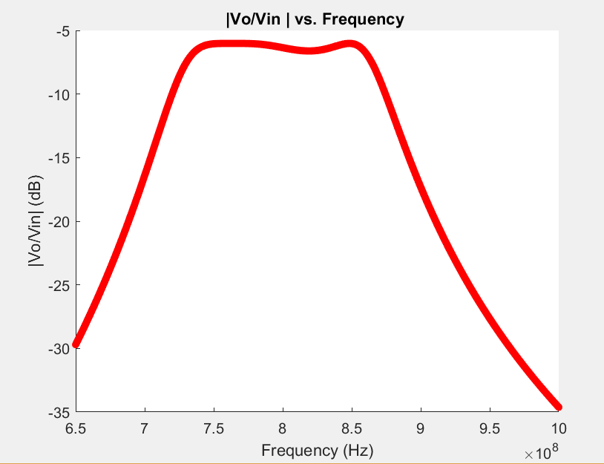
Fabricated RF Bandpass Filter
New Transfer Function
Based on parts available
from vendors

Slide 12
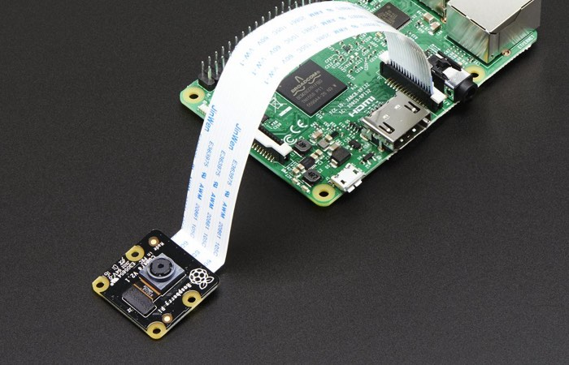
Change of Design: Computer
Refactoring required
Needed higher efficiency for slower processor
Hardware Change
Portability
Reliable ADC interfacing
Pi Camera Module v2
GPU vs CPU (encoding)

Slide 13
Analog to Digital Converter
ADS1256
Interfaced ADC with Sensor and Processing Subsystems
Sensor: AD8302
Interfaced with Power Subsystem and Pi GPIO
Processing: Pi SPI interface
C implementation with hardware interface libraries
Effective 4k samples/second on 8 channel SPI
Fed to computer for Localization process

Slide 14
Optimization: Processing Block Code
Sampling Algorithms
Implemented in C.
Sampling and logging @4k samples/sec
Localization Algorithms
Implemented in C. 0.01% error w/ MATLAB model.
Reading Sampling data @72k samples/sec
Computing positions @18k samples/sec (bottleneck)
Interfaced with Camera subsystem
Presentation
Logfile/Data file structure interfaced
Reading position logfile data @82k samples/sec

Slide 15
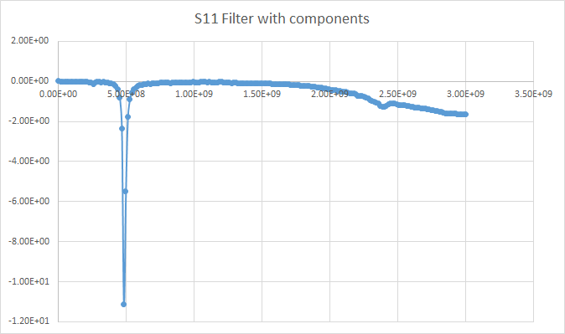
Fabricated RF Bandpass Filter

Slide 16
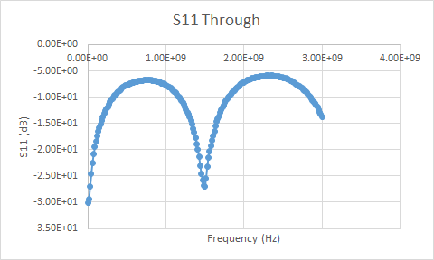
Fabricated RF Bandpass Filter

Slide 17
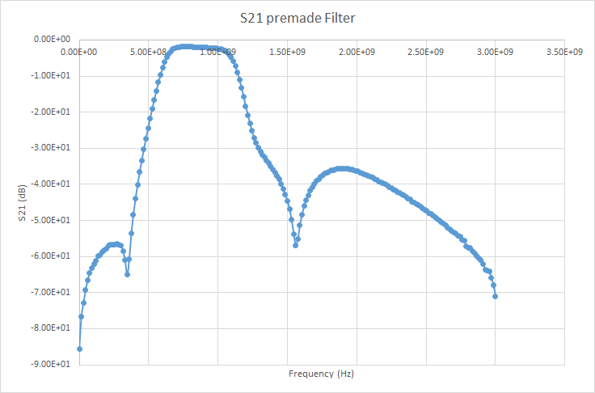
Premade RF Bandpass Filter

Slide 18
Proposed FDR Deliverables
Fully Integrated System
Full Antenna Array integrated
Camera integrated
GUI
Project Integrated with final enclosure

Slide 19
Cost Analysis
Initial Budget = $500
Expenses to Date:
Fabrication of (3) BPF’s based on our original design - $12
Acquisition of (1) 8-channel ADC - $20
Antennas (3) - $90
Mounting apparatus - $10
AD8302 phase detectors (3) - $90
SMD parts - $20
Current Total Cost ≈ $250
Notes:
SMA’s
Pi and Camera
Sampled Parts

Slide 20
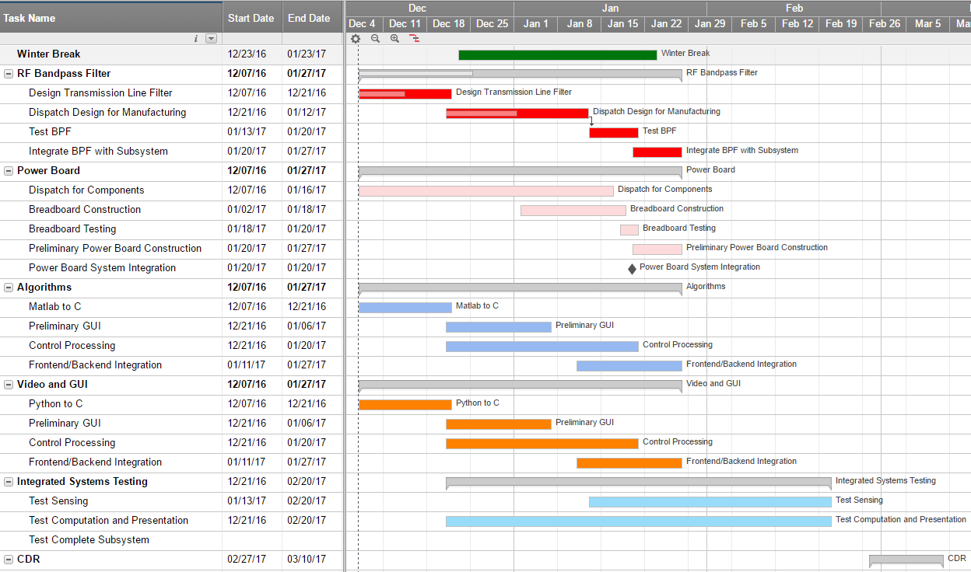

Slide 21
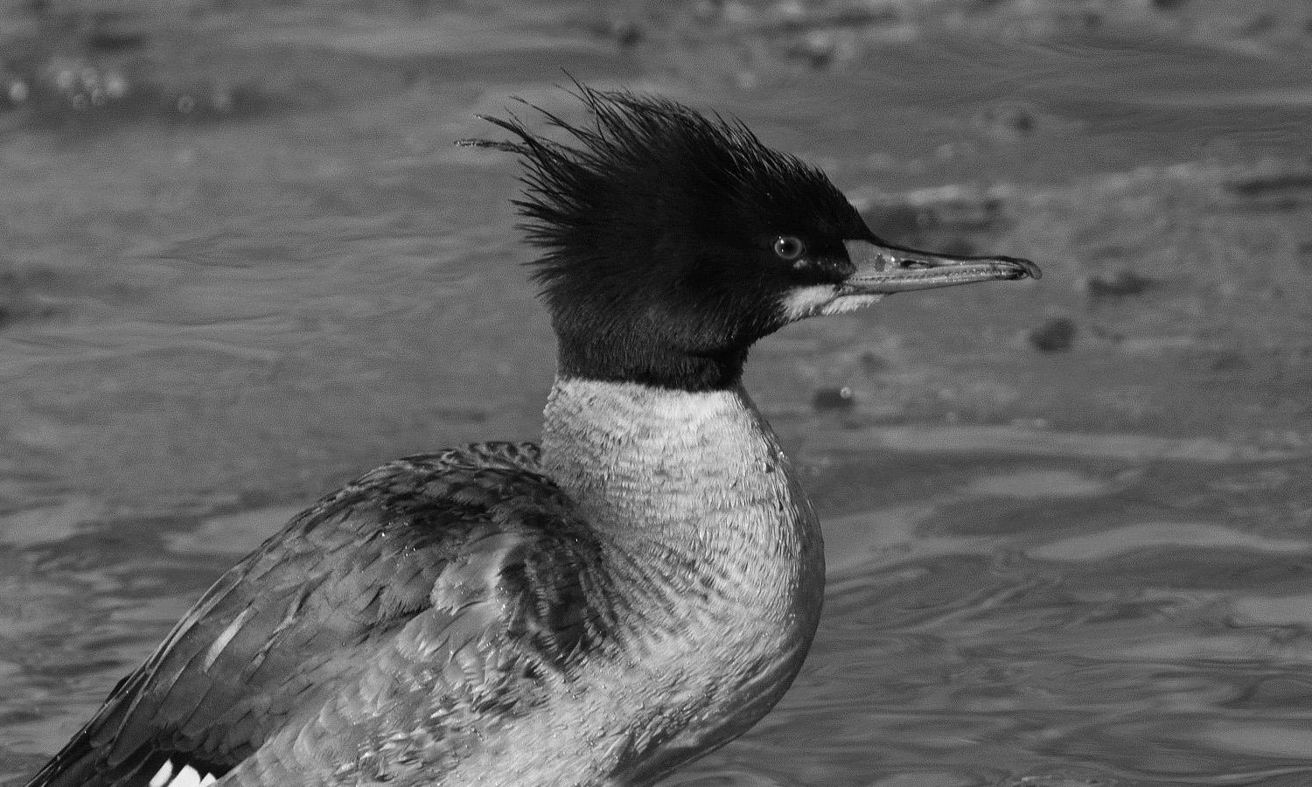
Questions?

